Slide 1
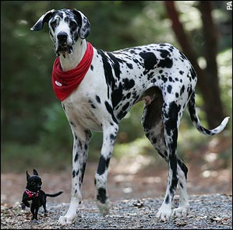
Quantitative Genetics
Estimate the number of polygenes for a quantitative trait.
Understand heritability.
Estimate the response in an artificial selection.

Slide 2
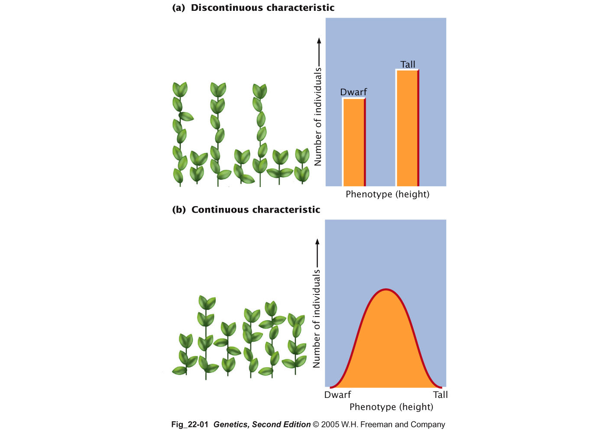

Slide 3
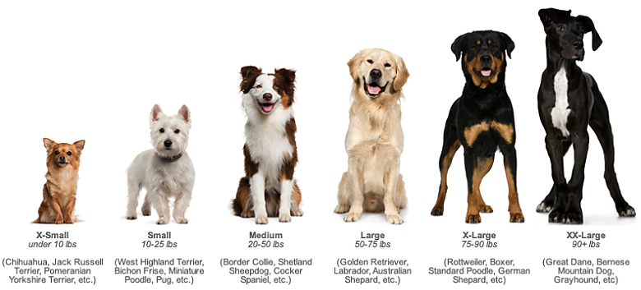

Slide 4
Quantitative inheritance
Many traits show a continuous range of phenotypes. Continuous variation is measured and described in quantitative terms and is known as quantitative inheritance.
A continuous quantitative trait is often the result of polygenic inheritance and is frequently multifactorial.
Multifactorial traits are influenced by both genetic and environmental factors.

Slide 5
Meristic traits
Meristic traits are polygenic traits in which the phenotype is recorded by counting whole numbers. They are quantitative traits but do not have an infinite range of phenotypes. For example, the number of peas in a pod.

Slide 6
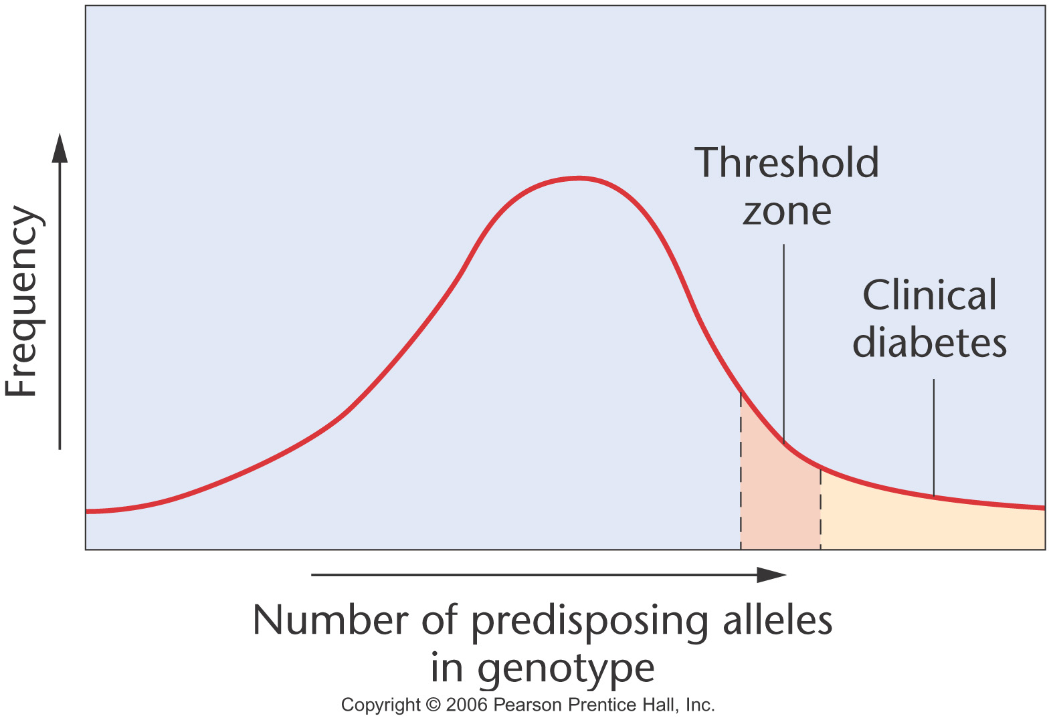
Threshold traits
Threshold traits are polygenic and often multifactorial but have a small number of discrete phenotypic classes

Slide 7
Can quantitative traits be explained in Mendelian terms?
Quantitative traits can be explained in Mendelian terms by many genes, each behaving individually in Mendelian fashion, contributing to the phenotype in a cumulative or quantitative way.
This multiple-factor hypothesis is demonstrated by grain color in wheat.

Slide 8
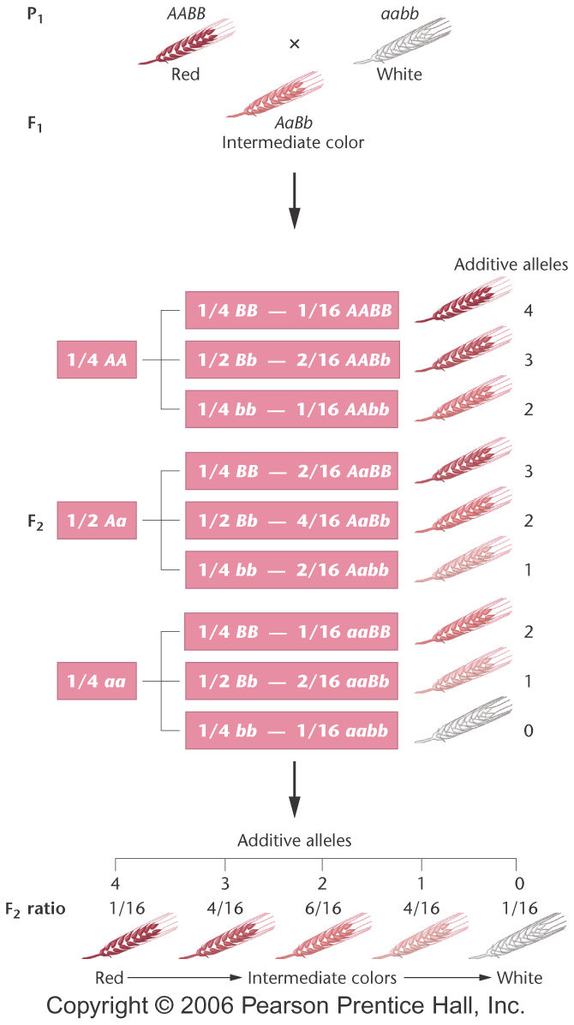
Wheat grain color
This trait is controlled by two genes, each of which segregates independently in Mendelian fashion. Each gene has an additive allele and a non-additive allele.
Notes:
Figure 24-2 How the multiple-factor hypothesis counts for the 1:4:6:4:1 phenotypic ratio of grain color when all alleles designated by an uppercase letter are additive and contribute an equal amount of pigment to the phenotype.

Slide 9
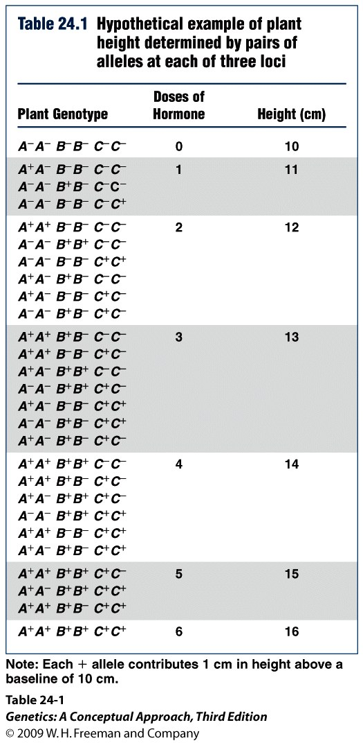
Additive alleles
Additive alleles contribute to a single quantitative character, and the phenotypic contribution of each additive allele is approximately equal. Thus, additive alleles together produce substantial phenotypic variation.

Slide 10
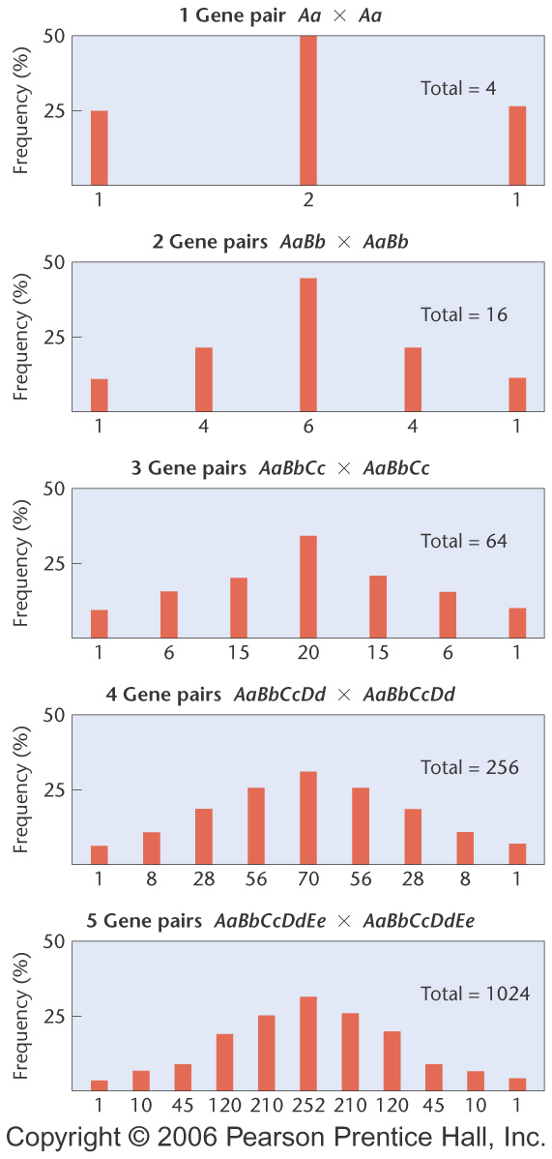
The expected results of polygenic inheritance for one to five gene pairs
Notes:
Figure 24-3 The results of crossing two heterozygotes when polygenic inheritance is in operation with 1–5 gene pairs. Each histogram bar indicates a distinct F2 phenotypic class from one extreme (left end) to the other extreme (right end). Each phenotype results from a different number of additive alleles.

Slide 11
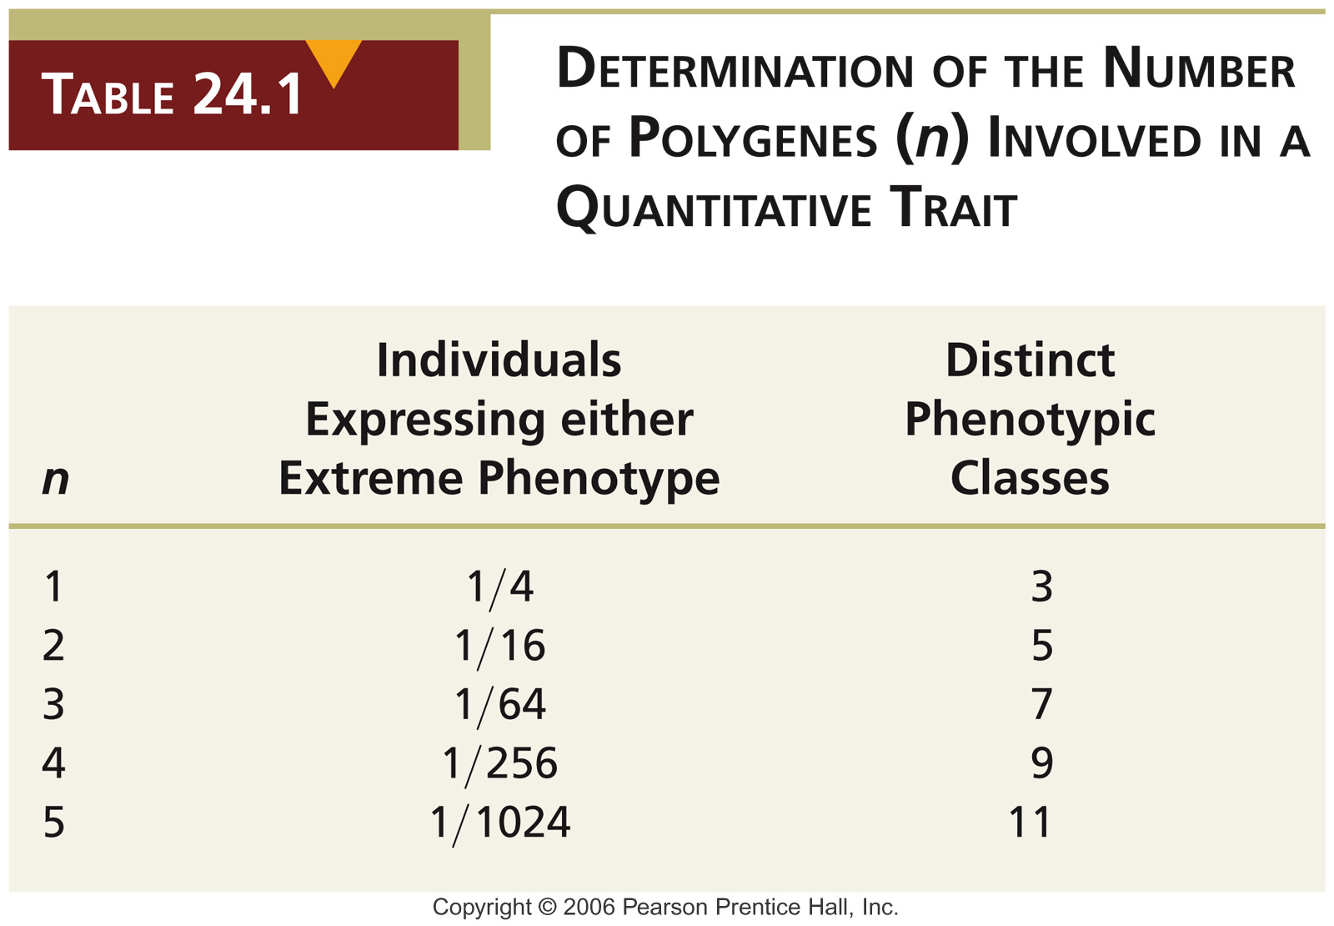
Notes:
Table 24-1 Determination of the Number of Polygenes (n) Involved in a Quantitative Trait

Slide 12
To estimate the number of genes involved
The number of genes (n) contributing to a quantitative trait can be estimated based on the ratio of F₂ individuals resembling either of the two extreme P₁ phenotypes.
1/4^{n} = ratio of F₂ individuals expressing either extreme phenotype.

Slide 13
Example question
A homozygous plant with 20 cm diameter flowers is crossed with a homozygous plant of the same species that has 40 cm diameter flowers. The F₁ plants all have flowers 30 cm in diameter. In the F₂ generation of 512 plants, 2 plants have flowers 20 cm in diameter, 2 plants have flowers 40 cm in diameter and the remaining 508 plants have lowers of a range of sizes in between.
Assuming that all alleles involved act additively, how many genes control flower size in this plant?

Slide 14
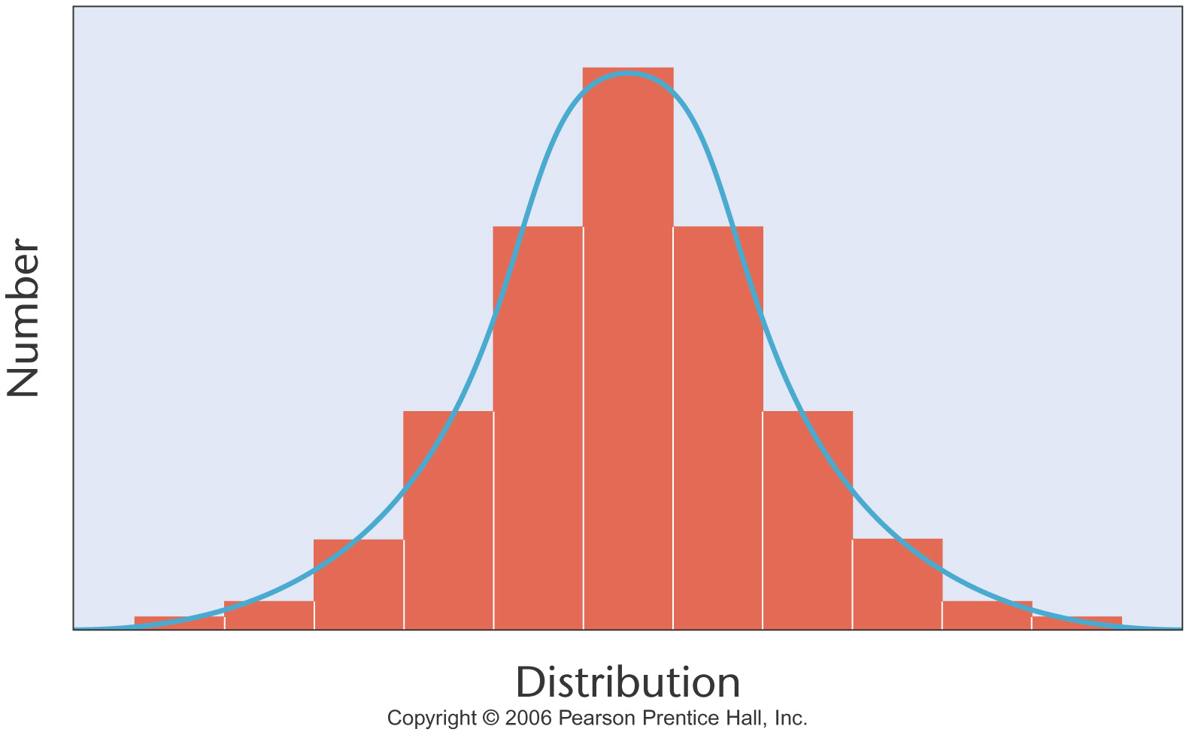
Some statistics…
Polygenic traits are usually measured in a sample of individuals that is large and representative of the population from which it is drawn. The data often form a normal distribution.

Slide 15
Mean, variance, and stand deviation
The mean is the arithmetic average of a set of measurements.
The variance is the average squared distance of all measurements from the mean. The variance provides information about the spread of data around the mean.
Standard deviation is the square root of the variance.
More than 95% of all values are found within two standard deviations to either side of the mean

Slide 16
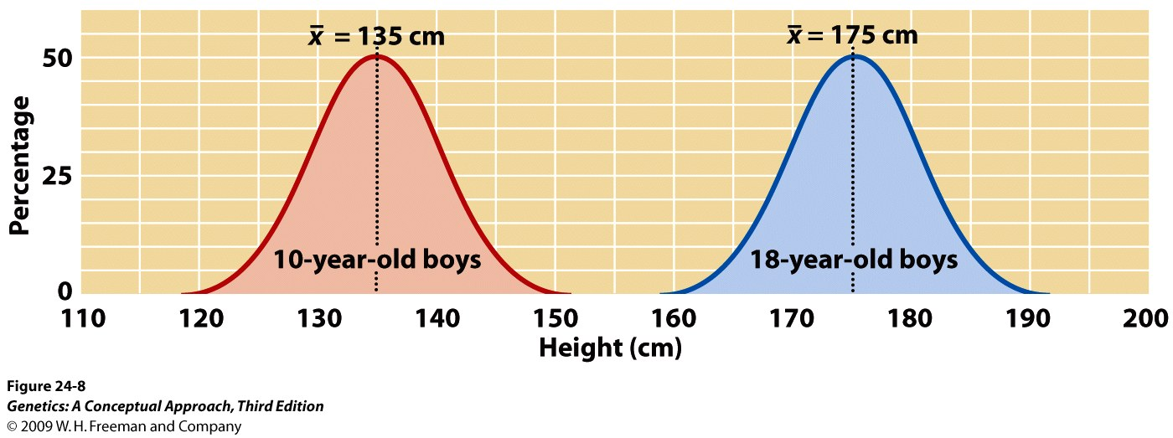
Notes:
Figure 24.8 The mean provides information about the center of a distribution. Both distributions of heights of 10-year-old and 18-year-old boys are normal, but they have different locations along a continuum of height, which makes their means different.

Slide 17
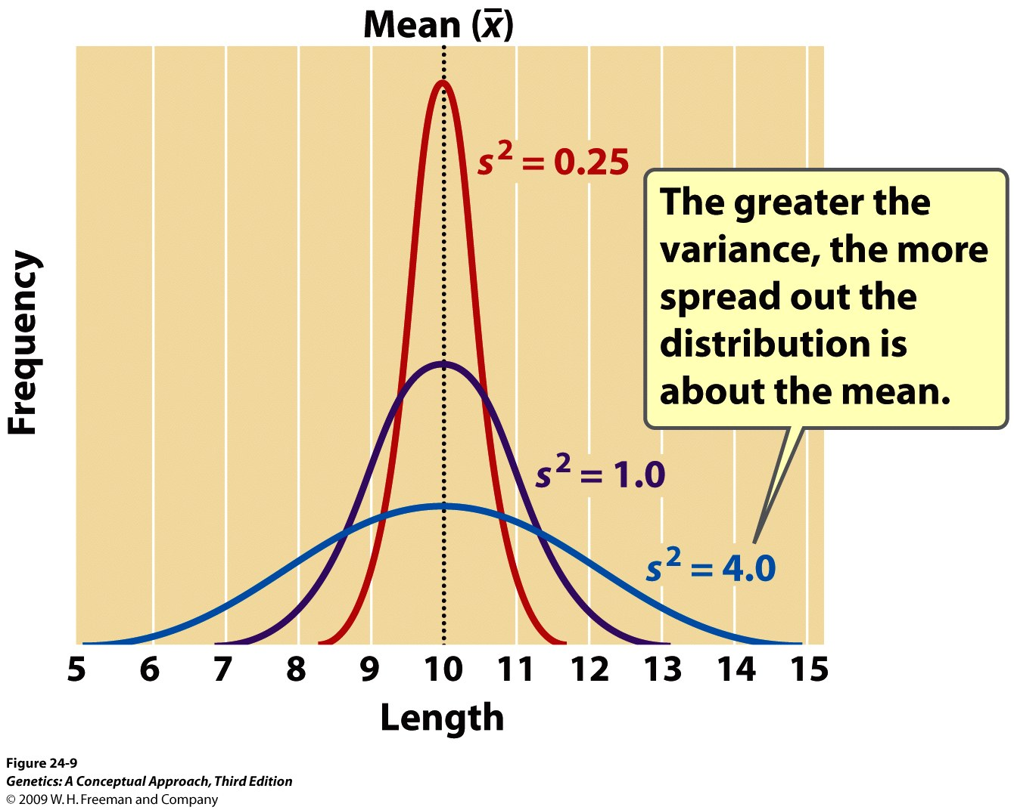
Notes:
Figure 24.9 The variance provides information about the variability of a group of phenotypes. Shown here are three distributions with the same mean but different variances.

Slide 18
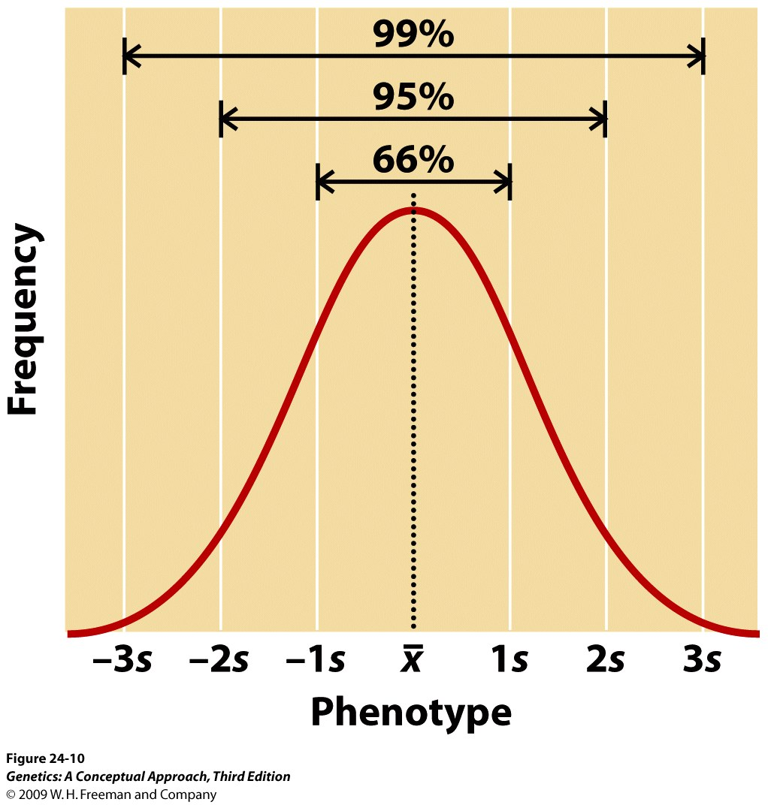
Notes:
Figure 24.10 The proportions of a normal distribution occupied by plus or minus one, two, and three standard deviations from the mean.

Slide 19
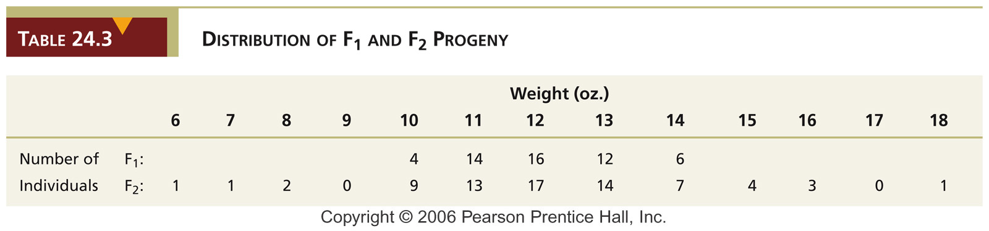
Example question
Calculate the mean and variance of both F₁ and F₂ progeny
Notes:
Table 24-3 Distribution of F₁ and F₂ Progeny

Slide 20
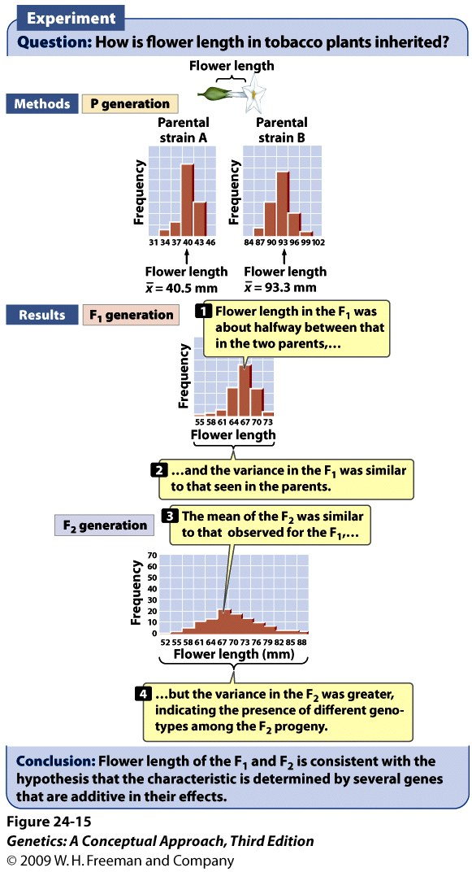
Notes:
Figure 24.15 Edward East conducted an early statistical study of the inheritance of flower length in tobacco.

Slide 21
Phenotypic variance has different components
Phenotypic variance has genotypic variance, environmental variance, and genotype-by-environment interaction variance components.
V_{P}=V_{G}+V_{E}+V_{G x E}

Slide 22
Broad-sense heritability (H²)
Broad-sense heritability measures the contribution of the genotypic variance to the total phenotypic variance. The genotypic variance component includes all types of genetic variation in the population and assumes that the genotype-by-environment variance component is negligible.
H² = V_{G}/V_{P}

Slide 23
Meaning of Heritability
Heritability describes the proportion of total phenotypic variation in a population due to genetic factors, but it does not indicate how much of a trait is genetically determined or the extent to which an individual's phenotype is due to genotype.
A heritability estimate tells the proportion of phenotypic variation that can be attributed to genetic variation within a certain population in a particular environment.

Slide 24
Narrow-sense heritability (h²)
Narrow-sense heritability is the proportion of phenotypic variance due to additive genotypic variance alone. Additive genotypic variance is partitioned into additive variance, dominance variance, and interactive variance.
V_{G}=V_{A}+V_{D}+V_{I}
h² = V_{A}/V_{P}

Slide 25
Artificial selection
Artificial selection is the process of choosing specific individuals with preferred phenotypes from an initially heterogeneous population for future breeding. The purpose is to develop a population containing a high frequency of individuals with the desired traits.
h²=R/S
R is response and S is selection differential.

Slide 26
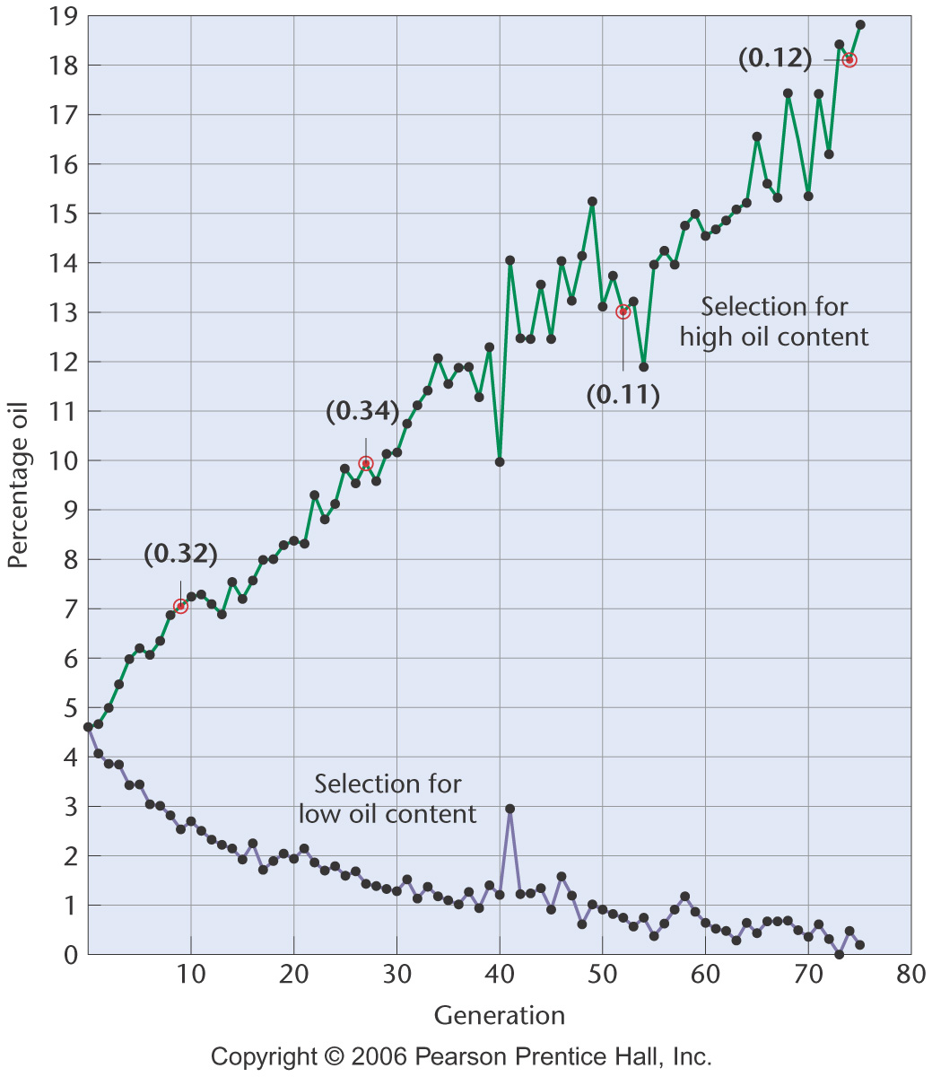
Figure 24-7 Copyright © 2006 Pearson Prentice Hall, Inc.
Notes:
Figure 24-7 Response of corn selected for high and low oil content over 76 generations. The numbers in parentheses at generations 9, 25, 52, and 76 for the “high oil” line indicate the calculation of heritability at these points in the continuing experiment.

Slide 27
Example question
In a population of tomato plants, mean fruit weight is 60 g and h² is 0.3. Predict the mean weight of the progeny if tomato plants whose fruit averaged 80 g were selected from the original population and interbred.

